Slide 1
Classification and Prediction ——Classification Accuracy——
徐华
清华大学 计算机系 智能技术与系统国家重点实验室
xuhua@tsinghua.edu.cn

Slide 2
Classification and Prediction
Basic Concepts
Issues Regarding Classification and Prediction
Decision Tree
Bayesian Classification
Neural Networks
Support Vector Machine
Support Vector Machine
K-Nearest Neighbor
Associative classification
Classification Accuracy

Slide 3
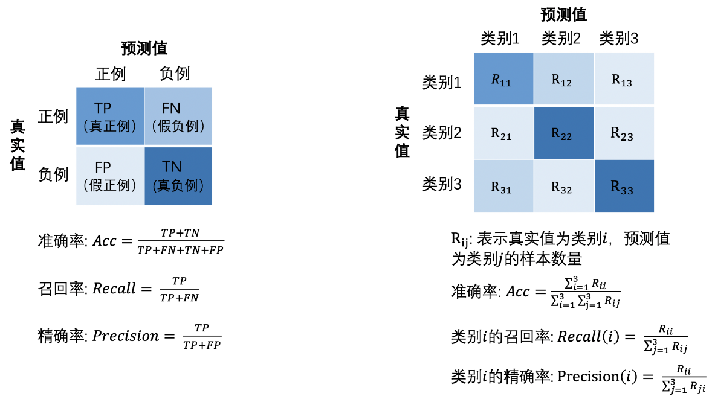
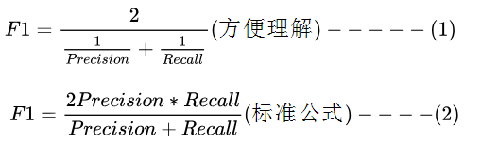
Classification Accuracy: Estimating Error Rates
Related to one special test data set.
Accuracy(准确率), Precision (精确率) and Recall (召回率)
The corresponding computation formula are listed as the following.
Accuracy （准确率，针对所有类别而言，平均分类效果）
Precision （精确率，针对某个类别而言）
Recall （召回率，针对某个类别而言）
F1 Score
(精确率与召回率的调和平均)

Slide 4
Classification Accuracy: Estimating Error Rates
Partition: Training-and-testing
use two independent data sets, e.g., training set (2/3), test set(1/3)
used for data set with large number of samples
Cross-validation
divide the data set into k subsamples
use k-1 subsamples as training data and one sub-sample as test data—k-fold cross-validation
for data set with moderate size

Slide 5
Bagging and Boosting
General idea : sampling
Training data
Altered Training data
Altered Training data
……..
Aggregation ….
Classification method (CM)
Classifier C
CM
Classifier C1
CM
Classifier C2
Classifier C*

Slide 6
Bagging
Given a set S of s samples
Generate a bootstrap(引导程序) sample T from S. Cases in S may not appear in T or may appear more than once.
Repeat this sampling procedure, getting a sequence of k independent training sets
A corresponding sequence of classifiers C1,C2,…,Ck is constructed for each of these training sets, by using the same classification algorithm
To classify an unknown sample X, let each classifier predict or vote
The Bagged Classifier C* counts the votes and assigns X to the class with the “most” votes

Slide 7
Boosting Technique — Algorithm
Assign every example an equal weight 1/N
For t = 1, 2, …, T Do
Obtain a hypothesis (classifier) h^{(t)} under w^{(t)}
Calculate the error of h(t) and re-weight the examples based on the error . Each classifier is dependent on the previous ones. Samples that are incorrectly predicted are weighted more heavily
Normalize w^{(t+1)} to sum to 1 (weights assigned to different classifiers sum to 1)
Output a weighted sum of all the hypothesis, with each hypothesis weighted according to its accuracy on the training set

Slide 8
Boosting Technique — Algorithm
k, the number of classifiers
Di, the ith training set sampling from S,
Mi, the classifier of ith model corresponding to Di
n, the number of the samples in each Di
Boosting Algorithm:
1 for i=1 to k
2 construct Di;
3 initialize weights of each sample(1/n);
4 construct Mi using Di;
5 evaluate classifier err(Mi); (if err(Mi)>threshold, then go to 2)
6 update the weight of each sample;
7 endfor
8 calculate the weight for each classifier Mi

Slide 9
Boosting Technique — Algorithm
construct Di
Sampling with the replacement strategy
Evaluate err(Mi)
Update weights of sample for x_{j}
Calculate the weights of k classifiers

Slide 10
Summary
Classification is an extensively studied problem (mainly in statistics, machine learning & neural networks)
Classification is probably one of the most widely used data mining techniques with a lot of extensions
Scalability is still an important issue for database applications: thus combining classification with database techniques should be a promising topic
Research directions: classification of non-relational data, e.g., text, spatial, multimedia, etc..

Slide 11
Thanks！
Notes:
工作新意图发现

